Slide 1

Introduction to Computer Science: Programming Methodology
Tutorial 8
Object oriented programming

Slide 2
Class and Object
Object Oriented Programming
Data fields/Attributes (属性): variables
Methods: functions
Template(模板)：
Class
Instances(实例)：
Object1
Object2
Object3
Id:***
State:
Behaviors:
Id:***
State:
Behaviors:
Id:***
State:
Behaviors:
Assigned values
Invoked

Slide 3

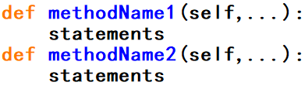
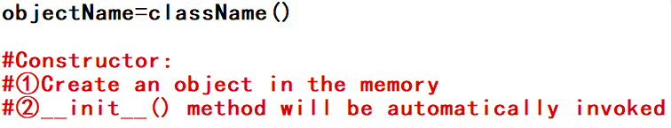
Class Definition
A default value can be set.
initializer
（“.” operator here connects object with its attributes, indicating the affiliation(从属关系) between them.）
methods
①A parameter(named “self” here) must be given to __init__() method to refer to the object you create by this template.
②Any methods you define in this class should have the parameter above(“self”) in order to invoke them using “.” operator to connect object and its method, i.e. when invoking you pass the object as a parameter to the method.

Slide 4
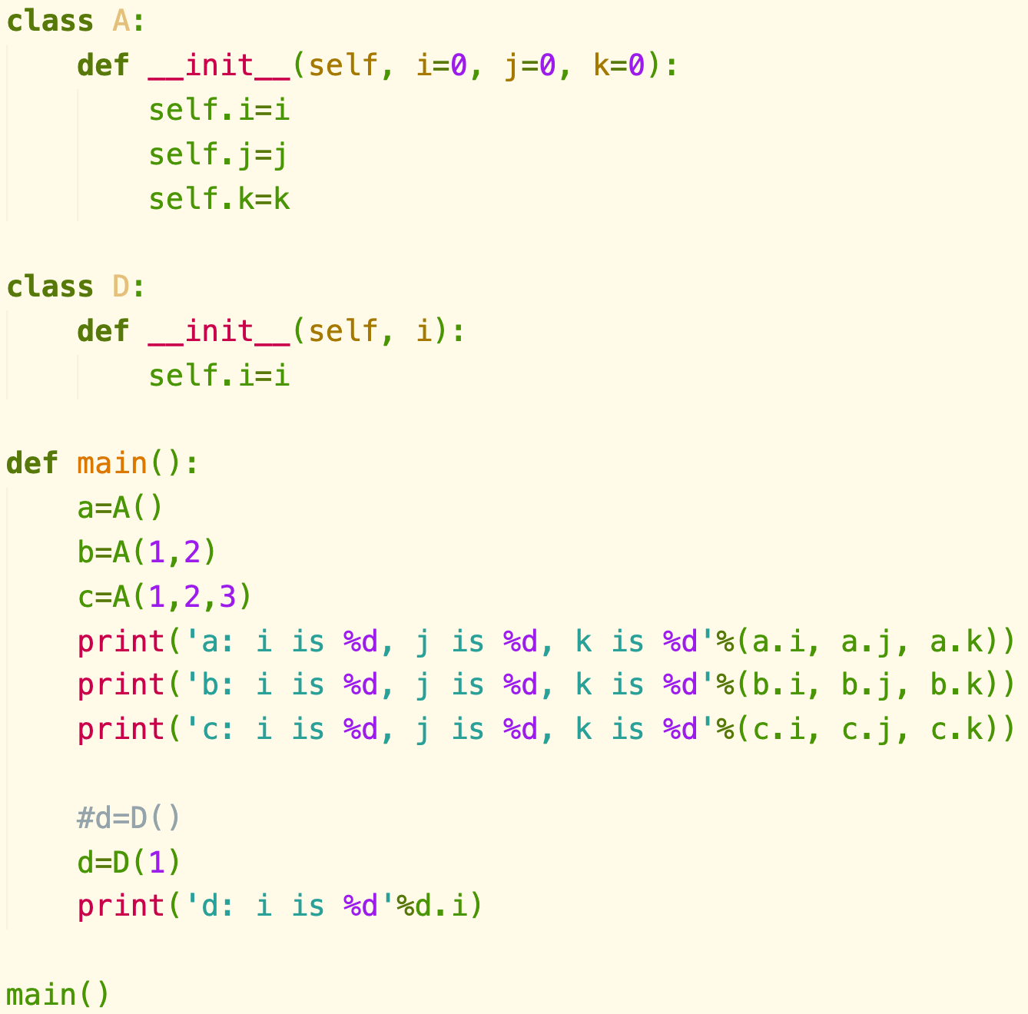
Class Definition
initialization.py

Slide 5
Private Data Fields/Methods
In Python, the private data fields are defined with two leading underscores. You can also define a private method named with two leading underscores
Private data fields and methods can be accessed within a class, but they cannot be accessed outside the class
Why we need private data fields and methods, which are not convenient to modify?
For others to use your programs, you need to provide a way for the users to get access to(by “getter”) and modify(but not directly and arbitrarily, by “setter”) the private data fields.
Getter:
Setter:
Tip: If a class is designed for other programs to use, to prevent data from being tampered with(e.g. bank account, score etc.) and to make the class easy to maintain, define data fields as private. If a class is only used internally by your own program, there is no need to hide the data fields.
Public Method to access private data!

Slide 6
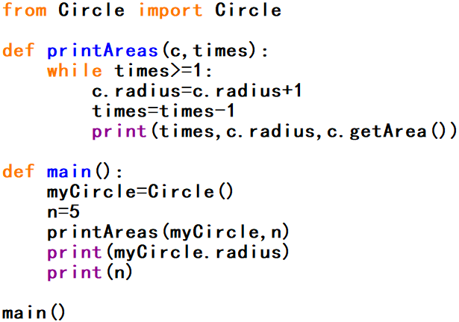
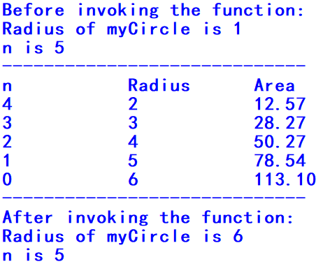
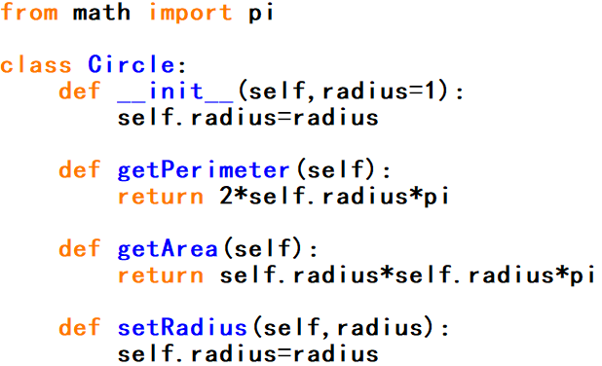
Mutable and Immutable Objects
In Python, some objects are mutable(e.g. lists, user defined class), others are immutable(e.g. strings, numbers, tuples).
If you pass some objects to a function where you may do some modifications to the parameters, then after invoking it, mutable objects will be changed while immutable ones won’t, compared with before.
Circle.py
(Output of an improved version.)

Slide 7
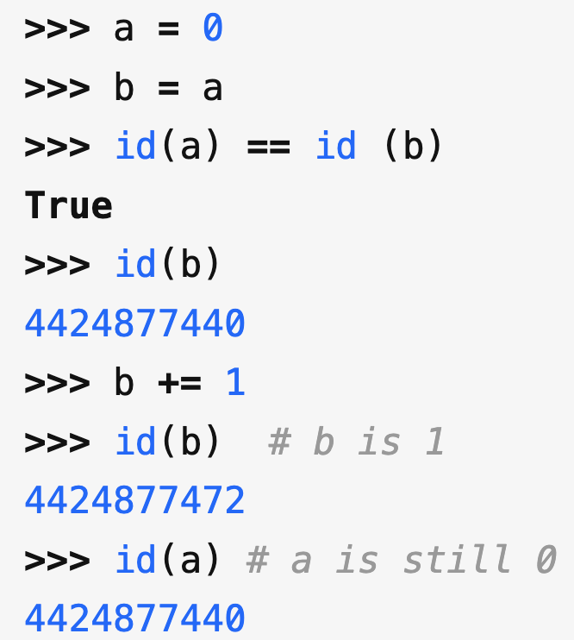
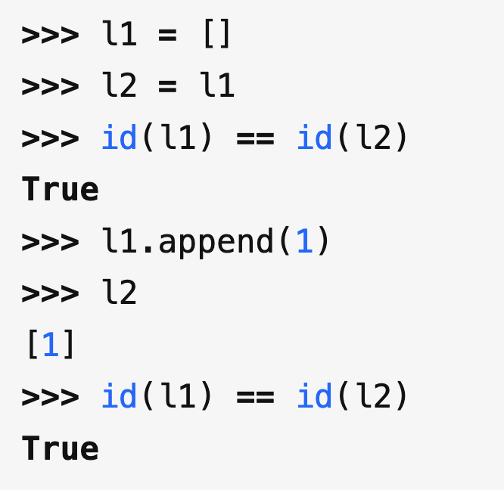
Mutable and Immutable Objects
Means that we create a NEW object b!
Immutable (e.g: int)
Mutable (e.g: List)

Slide 8
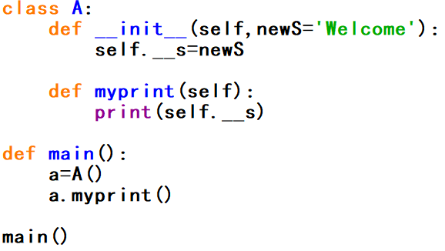
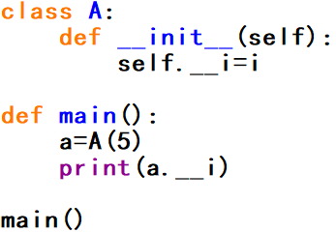
Q1: Private data fields
i) What problems arise in running the program (a)? How to fix it?
ii) Is the program (b) correct? If so, what will be the output?
(a)
(b)

Slide 9
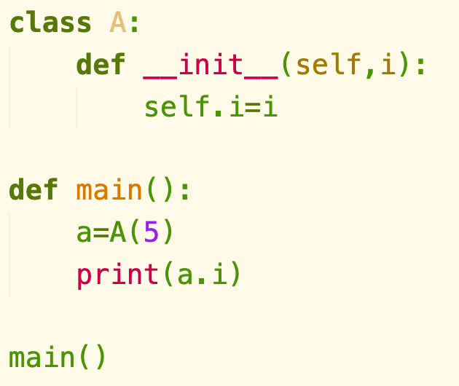
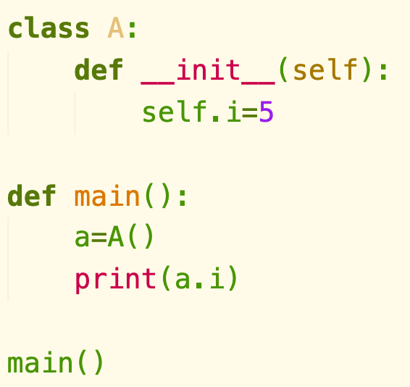
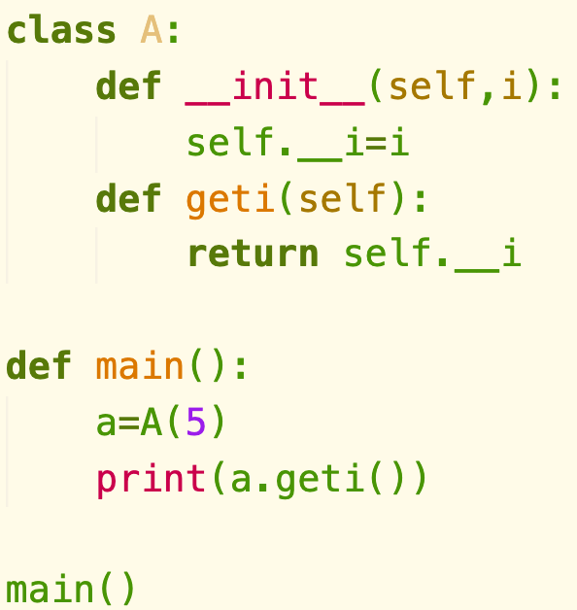
Q1: Private data fields

Slide 10
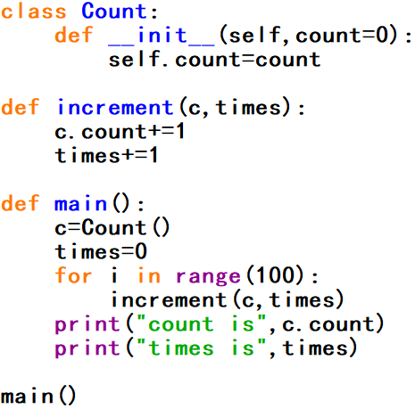
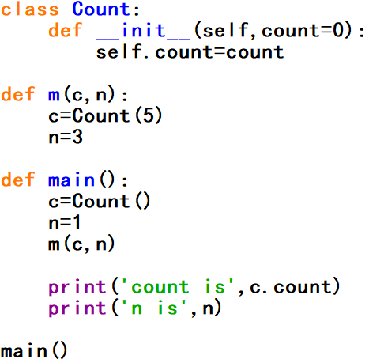
Q2: Mutable and immutable objects
Show the output of the following programs (a) and (b).
(a)
(b)

Slide 11
Q2: Mutable and immutable objects
Show the output of the following programs (a) and (b).
count is 100
time is 0
(a)

Slide 12
Q2: Mutable and immutable objects
Show the output of the following programs (a) and (b).
Here we create a NEW object!
count is 0
time is 1
Still the old one!
(b)

Slide 13
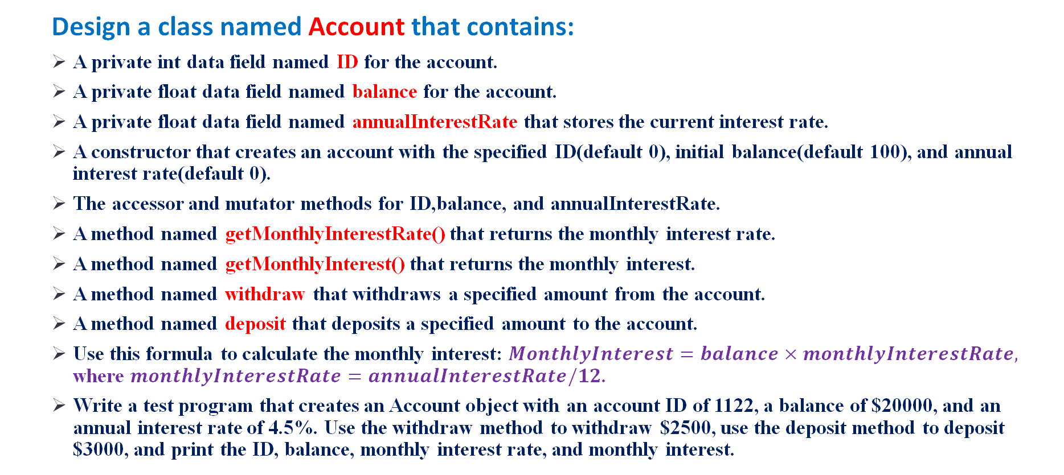
Q3: Account class
Design a class named Account that contains:
A private int data field named ID for the account.
A private float data field named balance for the account.
A private float data field named annualInterestRate that stores the current interest rate.
A constructor that creates an account with the specified ID(default 0), initial balance(default 100), and annual interest rate(default 0).
The accessor and mutator methods for ID,balance, and annualInterestRate.
A method named getMonthlyInterestRate() that returns the monthly interest rate.
A method named getMonthlyInterest() that returns the monthly interest.
A method named withdraw that withdraws a specified amount from the account.
A method named deposit that deposits a specified amount to the account.
Use this formula to calculate the monthly interest: $MonthlyInterest=balance×monthlyInterestRate,$ where $monthlyInterestRate=annualInterestRate/12$.
Write a test program that creates an Account object with an account ID of 1122, a balance of $20000, and an annual interest rate of 4.5%. Use the withdraw method to withdraw $2500, use the deposit method to deposit $3000, and print the ID, balance, monthly interest rate, and monthly interest.

Slide 14
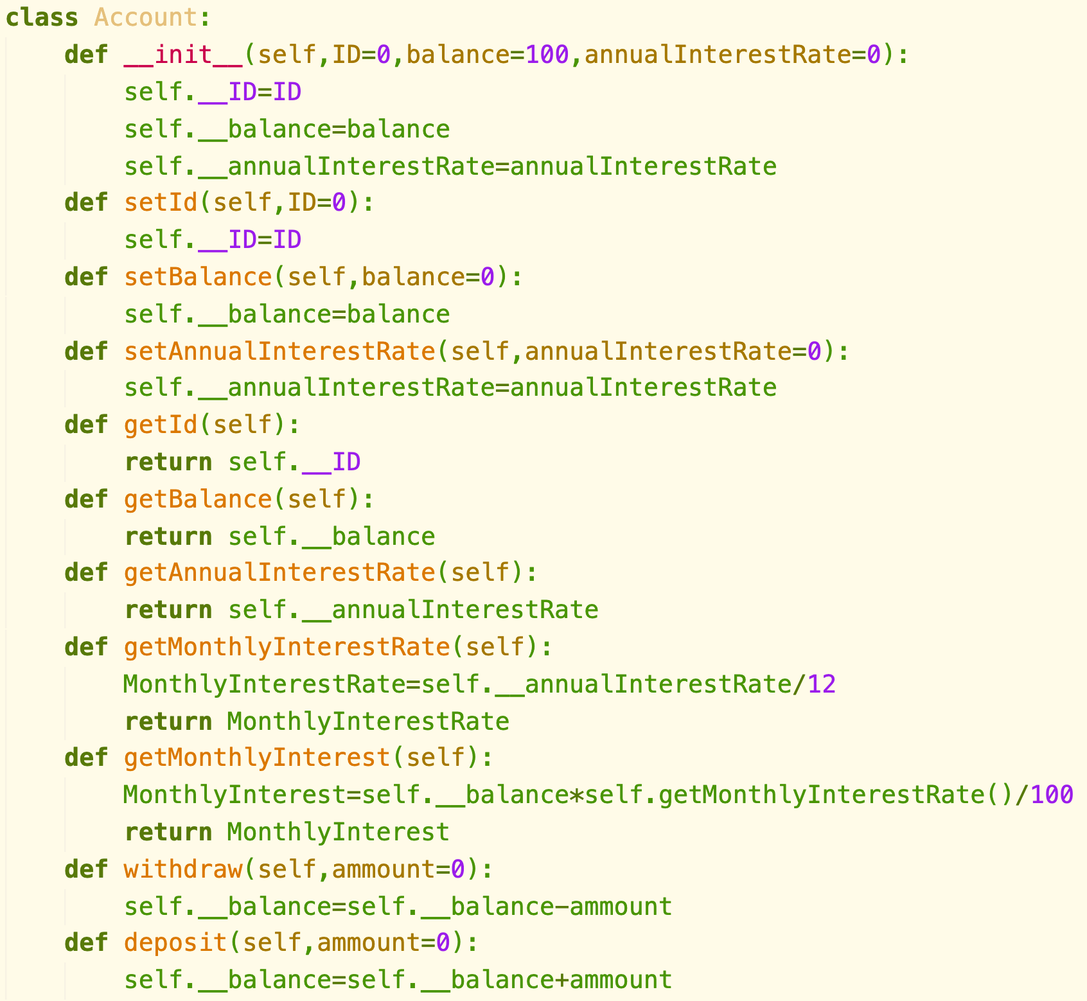
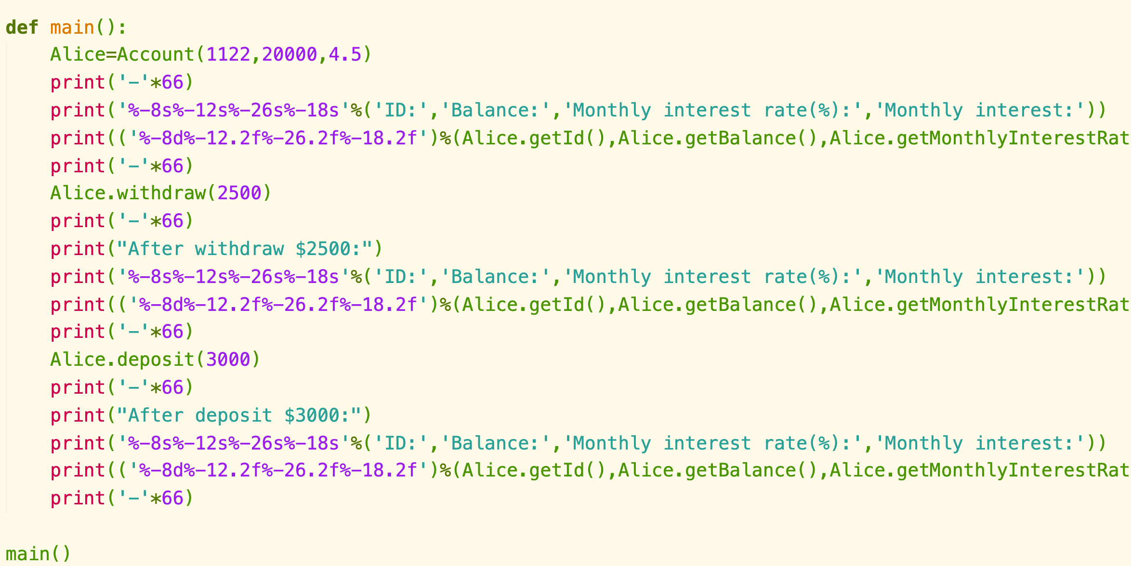
Q3: Account class

Slide 15
Q4: ATM machine
Use the Account class created in the previous practice to simulate an ATM machine. Create ten accounts in a list with the ids 0,1,..,9, and an initial balance of $100. The system prompts the user to enter an id. If the id is entered incorrectly, ask the user to enter a correct id. Once an id is accepted, the main menu is displayed as shown in the sample run next page. You can enter a choice of 1 for viewing the current balance, 2 for withdrawing money, 3 for depositing money, and 4 for exiting the main menu. Once you exit, the system will prompt for an id again. So, once the system starts, it won’t stop.

Slide 16
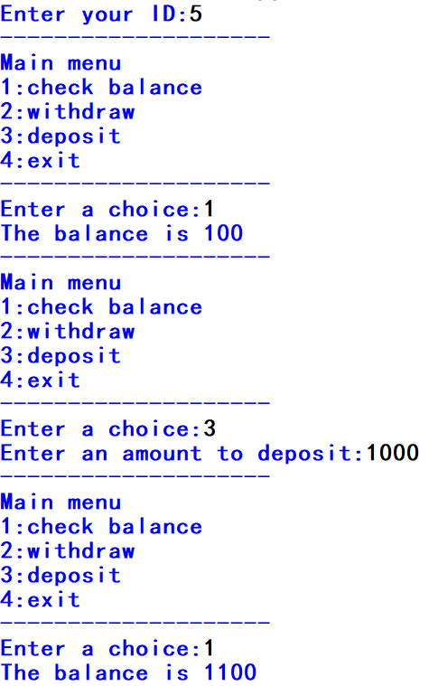
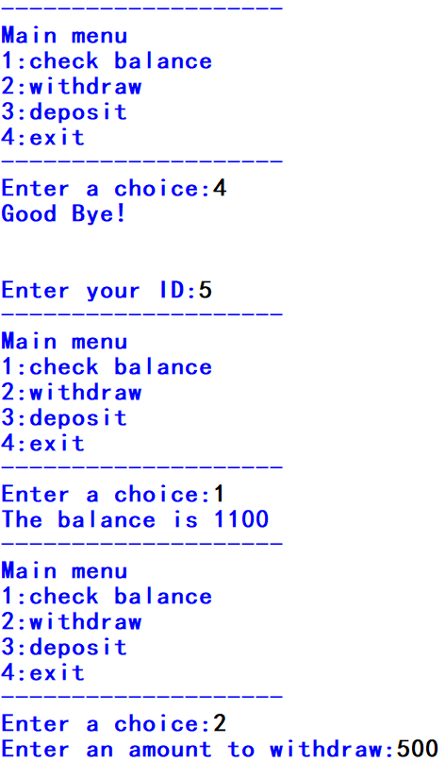
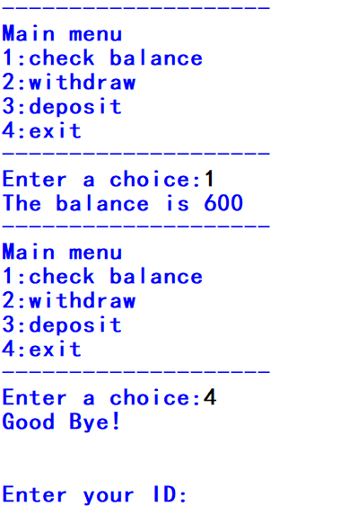
Q4: ATM machine(Sample run)
(For next user to input.)

Slide 17
